Slide 1
Walmart Frontline AI Transformation Enterprise Risk Assessment and Analytics
Presented by Group9

Slide 2
Agenda
Introduction
Business context
ERM Framework
Recommendation
Conclusion

Slide 3

Introduction
In this presentation, we will present our enterprise risk assessment of Walmart’s Frontline AI Transformation initiative. Our goal is to evaluate both the opportunities and risks associated with AI adoption and provide evidence-based recommendations for management.

Slide 4

Business Context

Slide 5
Business Context
Walmart Background & Current Position
Company Overview
Global Leadership
Current Operating Challenges
Founded in 1962
Headquarters: Bentonville, USA, Arkansas
Operates more than 10,000 stores globally
Serves approximately 255 million customers weekly
Employs over 2.1 million associates worldwide
World’s largest retailer by revenue
Extensive omnichannel ecosystem: physical stores, e-commerce, distribution centers, last-mile fulfillment network
Strong market position in grocery, general merchandise and online retail
Rising labor costs
Increasing customer expectations for speed and convenience
Inventory management complexity
Supply chain disruptions
Growing competition from AI-enabled retailers
Overall, Traditional retail operations are no longer sufficient to meet modern retail demands for speed, accuracy, and efficiency.

Slide 6
Business Context
Why is Walmart investing in AI and seek Transformation
Current Challenges
Operational Challenges:
Competitive Challenges:
Inventory Complexity
Labor shortages
Rising labor costs
Supply chain disruption
Amazon AI
Target AI
Increasing customer expectation
Before Frontline AI Transformation
Before Frontline AI Transformation
Manual scheduling
Reactive inventory replenishment
Paper-based receiving
Fixed staffing decisions
Manual customer service support
AI workforce scheduling
Predictive demand forecasting
Computer vision & sheif monitoring
AI-powered inventory management
Automation & real-time customer analytics
While AI offers significant operational benefits, it also introduces new risks related to technology, cybersecurity, governance, workforce adoption, and system reliability.
Notes:
AI is no longer optional. It is becoming a competitive necessity.

Slide 7
Business Context
Integrated Situation Assessment External Environment Analysis
Key External Factors affecting Walmart’s AI transformation
External Driver | Impact on AI Transformation | Related Risks
Economic Uncertainty | Budget pressure and ROI expectations | R4
Rapid Technology Change | Integration and system complexity | R6, R8
Cybersecurity Threats | Increased exposure to digital attacks | R7
Regulatory & AI Governance Requirements | Compliance and ethical AI obligations | R14
Competitive AI Adoption | Pressure to accelerate transformation | R1, R2
These external risk drivers formed the foundation for identifying and assessing the 18 enterprise risks associated with Walmart's Frontline AI Transformation.

Slide 8
Enterprise Risk Management Framework

Slide 9
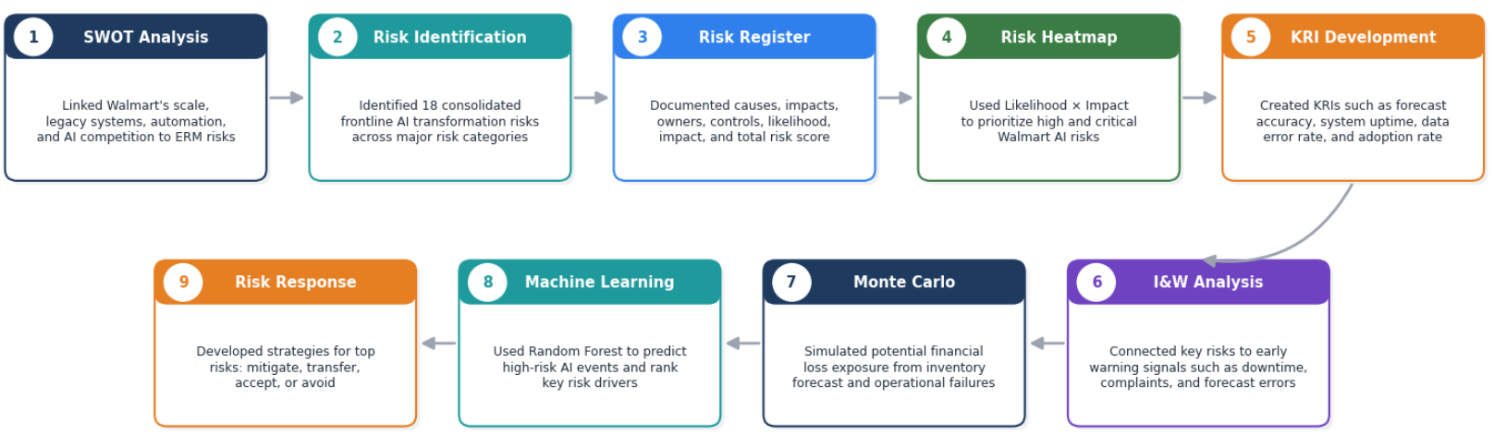
Enterprise Risk management framework
How did we assess the risks? Overview of Risk Workflow
A Project specific ERM workflow for Walmart Frontline AI Transformation
This workflow shows how our team converted Walmart’s frontline AI transformation challenges into measurable risks

Slide 10
Enterprise Risk management framework
Risk Identification Key Risks Introduced by Frontline AI Transformation
Walmart Frontline AI Transformation Initiatives includes:
Workforce Scheduling
Inventory Forecasting
Smart Store Operations
Customer Service Automation
Transformation affected these business processes
Workforce Management
Inventory Management
Store & Fulfillment Operations
Customer Service Process
Data & Tech Infrastructure
Risk Exposure Created
Operational Risks
Technical
Risks
Compliance Risk
Reputational Risks
Strategic Opportunity
Financial
Risks
Inventory Forecast error
Stockout risk
Fulfillment Disruption
Inventory imbalance
Workforce scheduling
Lagacy system integration failure
System downtime
AI platform unavailability
Data quality failure
Excessive dependence
Customer Data breach
Information security risk
Regulatory non-compliance and AI governance risk
Brand damage
Customer migration risk
Customer trust erosion
Negative public perception
AI-driven supply chain optimization and cost leadership opportunity
ROI realization failure
Revenue Loss from AI service disruption
Inventory loss
Expected labor cost
Notes:
Risk Identification Outcome
The transformation of six core operational processes resulted in 18 consolidated enterprise risks and one strategic opportunity.

Slide 11
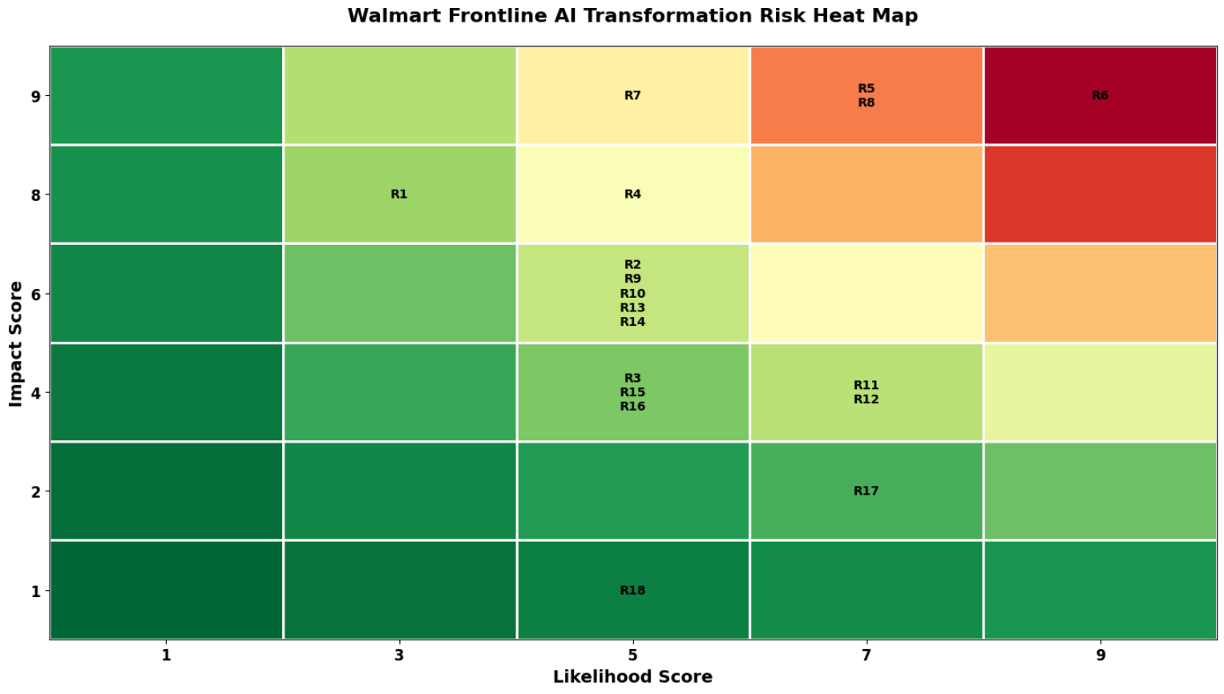
Enterprise Risk management framework
Risk Prioritization Using the heatmap Likelihood * Impact Analysis
Critical Risk Includes:
R6: Legacy system Integration failure and Vendor Dependency
R5: Inventory Forecast error, stockout risk and fulfillment Disruption
R8: System Downtime and AI Platform Unavailability
R7: Customer Data Breach and Information Security Risk
Notes:
This is our heatmap.

Slide 12
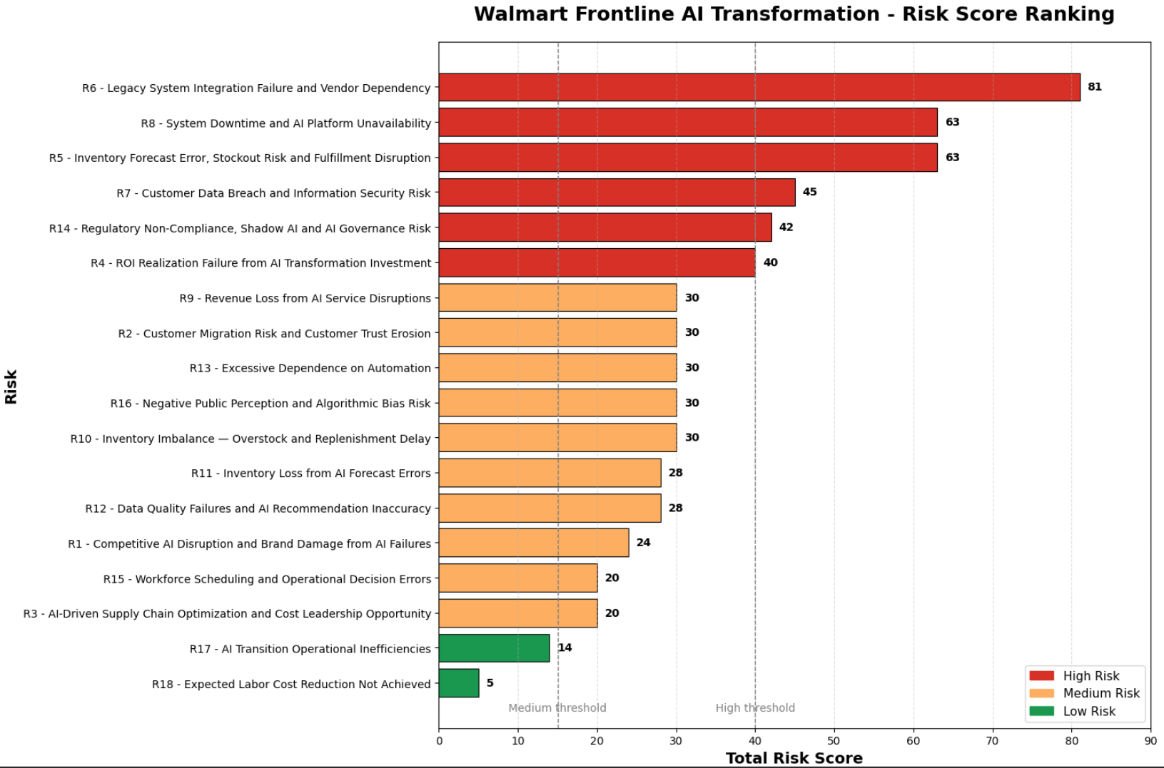
Enterprise Risk management framework
Risk Prioritization Using the heatmap Likelihood * Impact Analysis
These risks were identified as critical not only because they received the highest risk scores, but because they directly affect Walmart’s ability to successfully execute its AI transformation strategy. System integration, inventory forecasting, platform reliability, and cybersecurity represent the core operational and technological foundations of Walmart’s frontline operations. Failure in any of these areas could significantly impact revenue, customer experience, and long-term transformation outcomes.
Notes:
Also, you can see Risk score ranking. These risks were identified as critical not only because they received the highest risk scores, but because they directly affect Walmart’s ability to successfully execute its AI transformation strategy. System integration, inventory forecasting, platform reliability, and cybersecurity represent the core operational and technological foundations of Walmart’s frontline operations. Failure in any of these areas could significantly impact revenue, customer experience, and long-term transformation outcomes.

Slide 13
Enterprise Risk management framework
Risk Prioritization Using the heatmap Likelihood * Impact Analysis
Based on research and understanding of Walmart scale, this is how we define those risk as Critical
R6: Legacy System Integration Failure and Vendor Dependency
R8: System Downtime and AI Platform Unavailability
Why high: AI systems must integrate with Walmart's existing inventory, fulfillment, and workforce management platforms. The scale and complexity of these legacy systems significantly increase implementation risk.
Potential Impact: AI deployment failure, operational disruption
Why high: Frontline operations increasingly depend on AI-driven scheduling, inventory management, and fulfillment systems. Platform outages can affect multiple business functions simultaneously.
Potential Impact: Service interruption, revenue loss
R5:Inventory Forecast error, stockout risk and fulfillment disruption
R7: Customer Data Breach and Information Security Risk
Why high: Inventory forecasting directly supports Walmart's store replenishment and fulfillment operations. Even small forecasting errors can affect thousands of stores and millions of products.
Potential Impact: Stockouts, lost sales, fulfillment disruption
Why high: AI transformation increases the volume of customer and operational data being processed, creating greater cybersecurity exposure.
Potential Impact: Fines, reputation damage, trust erosion

Slide 14
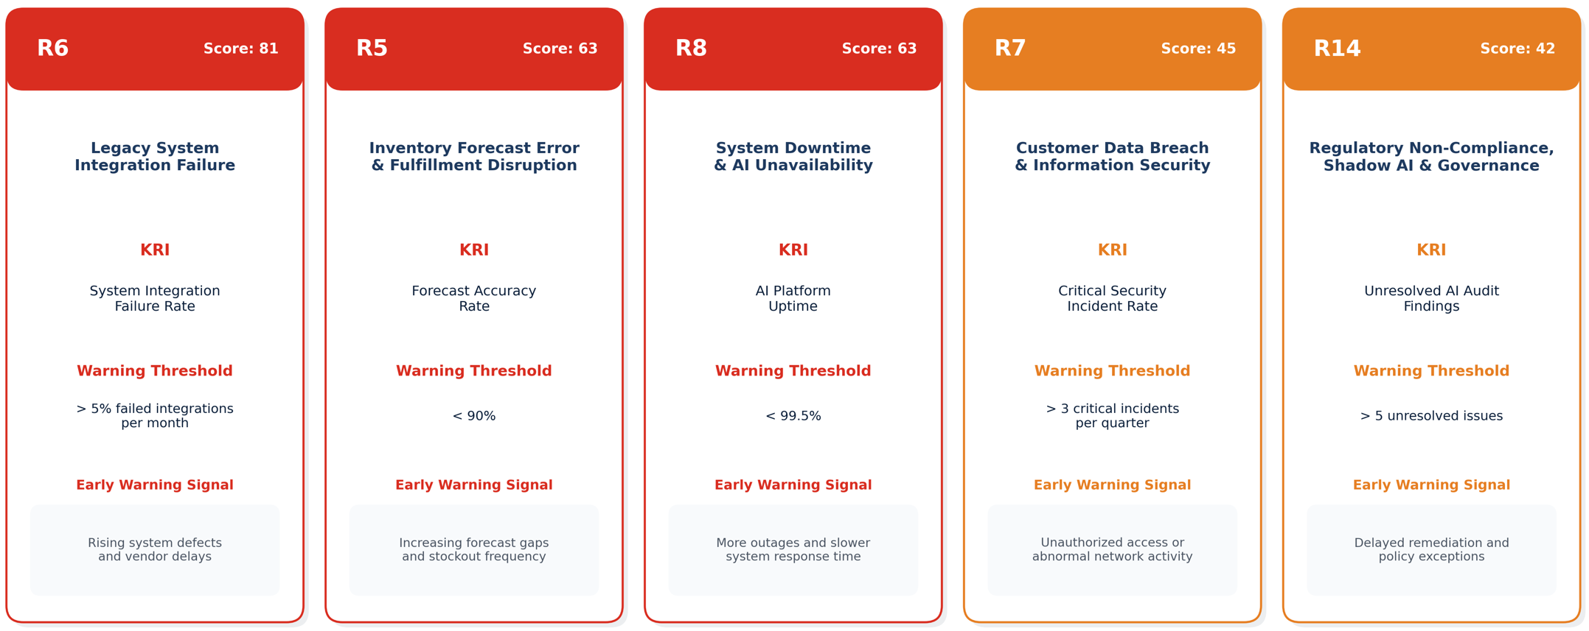
Enterprise Risk management framework
Key Risk Indicators (KRIs) Early Warning System
The purpose is to monitoring leading indicators to proactively manage Walmart's highest-priority AI risks
KRIs enable Walmart to proactively monitor critical AI risks and identify warning signs before operational, financial, security, or compliance issues escalate.
Notes:
After identifying and prioritizing the highest-risk areas, we developed Key Risk Indicators, or KRIs, to help Walmart monitor these risks on an ongoing basis.
We focused on the five highest-priority risks identified in the heatmap, including legacy system integration failure, inventory forecasting errors, system downtime, cybersecurity breaches, and AI governance risks.
For each risk, we defined a measurable indicator, a warning threshold, and an early warning signal. This allows management to detect emerging issues early and take corrective actions before they escalate into major operational, financial, or compliance incidents.

Slide 15
Enterprise Risk management framework
Quantitative Risk Assessment & L&W Analysis
The purpose of this step is to evaluating probability, financial impact and warning levels of key risks
Risk ID | Risk | Probability | Expected Loss
R5 | Inventory Forecast error, stockout risk and fulfillment Disruption | 68% | -$5.20B
R6 | Legacy system integration failure and vendor dependency | 75% | -$3.75B
R8 | System Downtime and AI platform Unavailability | 60% | -$4.80B
R7 | Customer data breach and information security risk | 45% | -$3.60B
R14 | Regulatory Non-compliance, shadow AI and AI governance risk | 55% | -$2.20B
Indicators & Warning Status
Key Insight
RED
R5 Inventory Forecast error
R6 Legacy system integration failure
Combining probability estimates, expected financial exposure, and warning indicators enables Walmart to identify which risks require immediate management attention and resource allocation.
AMBER
R7 Customer Data Breach
R8 System downtime
R14 AI governance Risk
GREEN
Remaining low-priority Risks
Notes:
After prioritizing risks through the heatmap, we conducted a quantitative risk assessment using probability estimates and expected financial exposure. The results show that inventory forecasting failures, legacy system integration issues, and system downtime represent the most significant financial threats to Walmart's AI transformation initiative. We also applied Indicators and Warning analysis to classify risks into red, amber, and green categories, helping management focus attention on the risks most likely to create operational and financial disruption. While the I&W analysis identifies which risks require attention today, Monte Carlo simulation helps us understand the range of potential future financial outcomes if these risks happenes.
（R5 and R6 are classified as Red, meaning they require immediate management attention. R7, R8, and R14 remain at the Amber level and should be closely monitored.）

Slide 16
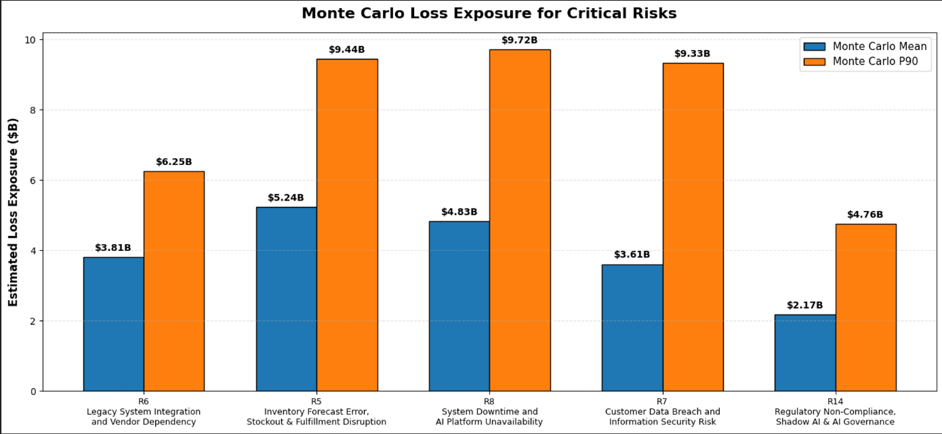
Enterprise Risk management framework
Monte Carlo: Estimate Potential Financial exposure Under Risk Uncertainty
The purpose of this step is to quantifying financial exposure from Walmart’s critical transformation risks
Key insights:
R5 Largest average financial exposure, means inventory-related disruptions generate the highest expected financial loss among all critical risks
R8 Highest worst-case scenario, means system outages create the most severe downside scenario, indicating significant financial exposure during major operational disruptions.
R6 Most likely critical risk, means integration failure remains the most likely critical risk to occur.
R7 & R14 Lower exposure but high consequence, means cybersecurity and governance failures can still result in substantial financial, legal, and reputational damage.
Monte Carlo simulation reveals that different risks create different types of exposure: some are more likely to occur, while others generate greater financial losses. Together, these insights help Walmart prioritize risk mitigation resources more effectively.
Notes:
So, the purpose of this page is to quantifying financial exposure. Unlike a single-point estimate, Monte Carlo simulation models thousands of possible scenarios to estimate potential financial exposure under uncertainty.
The chart compares the average simulated financial loss with the 90th percentile worst-case scenario for each critical risk.
We found that Inventory Forecast Error, Stockout Risk and Fulfillment Disruption has the highest average financial exposure, indicating that inventory-related disruptions could generate the greatest expected financial losses.
System Downtime and AI Platform Unavailability shows the highest worst-case financial exposure, suggesting that large-scale system outages could significantly disrupt Walmart's nationwide operations.
Legacy System Integration Failure and Vendor Dependency remains one of the most significant operational risks because implementation failures could affect the success of the entire AI transformation program.
Although Customer Data Breach and Information Security Risk and Regulatory Non-Compliance and AI Governance Risk have relatively lower financial exposure, they still represent substantial legal, regulatory, and reputational risks that require continuous management attention.
Monte Carlo simulation allows us to compare risk exposure from multiple perspectives. The results show that Inventory Forecast Error creates the highest average financial loss, while System Downtime produces the most severe worst-case scenario. At the same time, Legacy System Integration Failure remains the most likely critical risk to occur. These findings demonstrate that risk priority is not determined by a single factor, and different risks require different mitigation strategies and management attention.

Slide 17
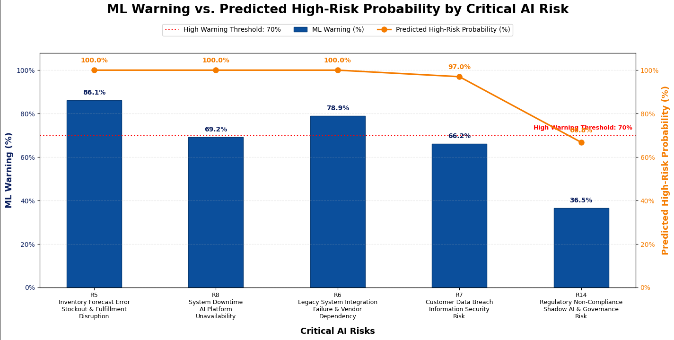
Enterprise Risk management framework
Machine Learning Validation Random Forest Prediction
The purpose of this step is to identify Walmart critical risks most likely to escalate during transformation
Key findings:
R5 Most critical operational risk with the highest warning and escalation probability.
R6 Major threat to AI transformation success due to integration complexity.
R8 Platform outages could quickly disrupt frontline operations at scale.
R7 Cybersecurity incidents remain a significant reputational and compliance concern.
R14 Lower short-term risk but requires ongoing AI governance monitoring.
Notes:
To complement our quantitative analysis, we trained a Random Forest model using 500 simulated risk scenarios generated from our final risk register.
The blue bars represent the current ML Warning level, which reflects the current warning status based on our risk indicators. The orange line represents the model's predicted probability that each critical risk could escalate into a major event.
Based on this threshold, Inventory Forecast Error and Legacy System Integration Failure exceed the warning level, indicating that these risks already require proactive intervention. System Downtime is very close to the threshold, suggesting it should also be closely monitored because a small deterioration could push it into the critical range.
The orange line represents the Random Forest prediction of how likely each risk is to escalate into a critical event. We found that Inventory Forecast Error, Legacy System Integration Failure, and System Downtime all have a 100% predicted escalation probability. This does not mean these events are guaranteed to occur. Rather, within our 500 simulated scenarios, these risks consistently emerged as the highest-priority events because of Walmart's large operational scale, highly integrated AI systems, and nationwide retail network, where failures can rapidly propagate across stores and supply chain operations.
Overall, the ML Warning tells management which risks need attention today, while the Random Forest prediction indicates which risks are most likely to become tomorrow's critical events.
（We selected 70% as the warning threshold because it provides a practical separation between risks requiring immediate action and those requiring enhanced monitoring. It follows the Indicators and Warning concept used throughout this project, rather than representing a fixed industry standard. Since our machine learning model was trained on simulated scenarios, the threshold serves as a management decision boundary instead of a statistical confidence level.）
We trained a Random Forest model using 500 simulated risk scenarios based on our final risk register.
The ML Warning indicates the current warning level, and we use 70% as the threshold for immediate management attention. Inventory Forecast Error and Legacy System Integration Failure are already above this threshold, while System Downtime is close behind.
The Predicted High-Risk Probability estimates future escalation risk. The 100% predictions do not mean these risks will definitely occur; they indicate that, under our simulated scenarios, they consistently became the highest-priority risks because of Walmart's business scale and integrated AI operations.

Slide 18
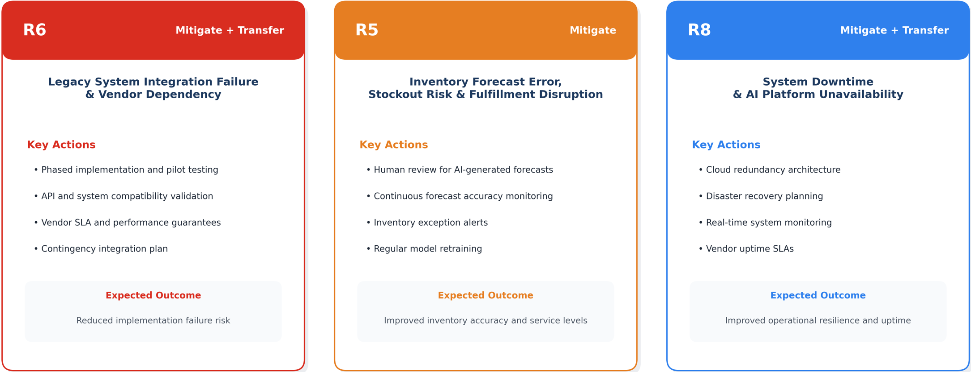
Enterprise Risk management framework
Risk Response Strategy How should Walmart respond?
Risk Response Strategy For Critical Risks
Walmart should prioritize mitigation and transfer strategies to reduce the operational and technology risks most likely to threaten AI transformation success. Risk avoidance is not practical because AI transformation is a strategic initiative，Avoiding these risks would require Walmart to delay or abandon its AI transformation initiative.
Notes:
Based on our analysis, we developed response strategies for the three most critical risks. For legacy system integration failure, Walmart should use phased implementation, pilot testing, and vendor service-level agreements to reduce implementation risk. For inventory forecasting errors, human oversight and continuous model monitoring are necessary to improve forecast accuracy and prevent stockouts. For system downtime, cloud redundancy, disaster recovery planning, and uptime agreements with vendors can improve operational resilience. Since AI transformation is a strategic initiative, avoiding these risks is not practical because Avoiding these risks would require Walmart to delay or abandon its AI transformation initiative.. Therefore, mitigation and transfer are the most appropriate response strategies.

Slide 19
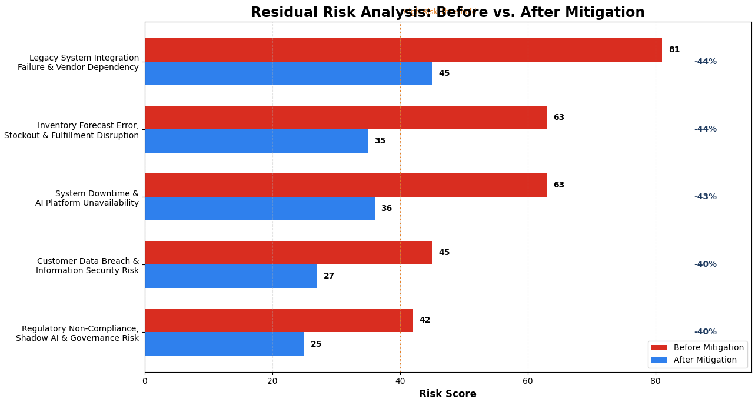
Enterprise Risk management framework
Residual Risk Analysis Before vs After Mitigation
Residual risk scores were estimated based on the expected effectiveness of proposed mitigation controls. Controls such as phased rollout, redundancy, and governance oversight primarily reduce likelihood, while some controls also reduce operational impact.
Assumption:
Residual risk scores assume that the proposed mitigation controls are fully implemented, adequately funded, and operating effectively. Actual residual risk may vary depending on implementation success and organizational adoption.
Notes:
This chart shows the estimated residual risk levels after applying our proposed mitigation strategies. It is important to note that these results are based on the assumption that the controls are fully implemented, adequately funded, and operating effectively. The objective is not to eliminate risk entirely, but to reduce risk to a more acceptable level. We can see that all five critical risks experience meaningful reductions, with the largest improvements observed in system integration, inventory forecasting, and platform availability. However, residual risks remain, particularly for technology and operational areas, which means continuous monitoring through KRIs, governance processes, and management oversight is still required. Overall, the analysis suggests that Walmart can significantly reduce risk exposure while continuing to realize the benefits of AI transformation.

Slide 20
Recommendations

Slide 21
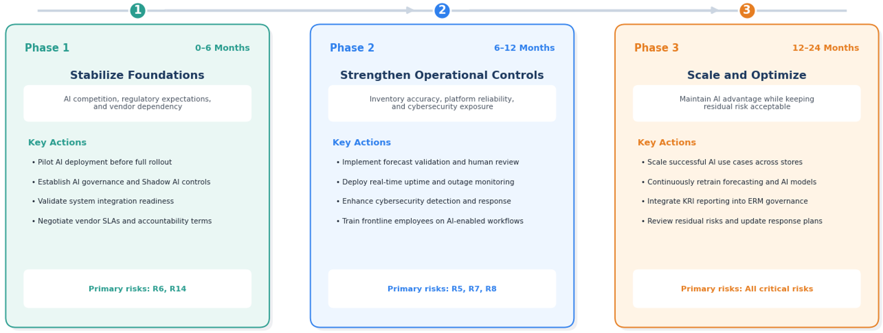
Recommendations
Strategic Recommendations & Implementation Roadmap
A phased approach to managing Walmart’ s frontline AI Transformation risk
Walmart Future Success Factors:
Governance
Technology
People
Monitoring
Strong oversight and accountability
Reliable infrastructure and integration
Workforce adoption and training
Continuous KRI and risk review
Notes:
Based on our risk assessment, quantitative analysis, and mitigation planning, we recommend a phased implementation roadmap for Walmart's frontline AI transformation.
In Phase 1, Walmart should focus on building a strong foundation by establishing AI governance, validating system integration readiness, and strengthening vendor management. These actions primarily address the highest-priority risks of system integration failure and AI governance.
In Phase 2, the focus shifts to operational controls. Walmart should improve forecast validation, enhance cybersecurity monitoring, and strengthen platform reliability to reduce inventory disruption, data breach, and system downtime risks.
In Phase 3, Walmart can scale successful AI initiatives across the organization while continuously retraining AI models and integrating KRI reporting into the enterprise risk management framework.
Finally, the success of this roadmap depends on four key factors: strong governance, reliable technology infrastructure, workforce adoption and training, and continuous risk monitoring. Together, these elements will help Walmart balance innovation with effective risk management.

Slide 22
Recommendations
Conclusion
In conclusion, Walmart should proceed with Walmart’s frontline AI transformation
But some implementation should be applied:
Strong AI governance
Phased deployment
Continuous KRI monitoring
Cybersecurity Controls
Vendor Management & Integration oversight
Notes:
In conclusion, Walmart's frontline AI transformation offers significant opportunities to improve operational efficiency, inventory management, workforce scheduling, and customer experience. However, our ERM analysis identified five critical risks that could threaten transformation success if not properly managed. Through heatmap analysis, KRIs, Monte Carlo simulation, and machine learning assessment, we determined that system integration, inventory forecasting, platform reliability, cybersecurity, and AI governance require the highest level of management attention. Based on our findings, we recommend that Walmart continue investing in AI transformation, but only through a phased implementation approach supported by strong governance, continuous monitoring, and effective risk controls. This approach allows Walmart to capture AI-driven value while maintaining risk within an acceptable range.

Slide 23

Thank you

